Slide 1
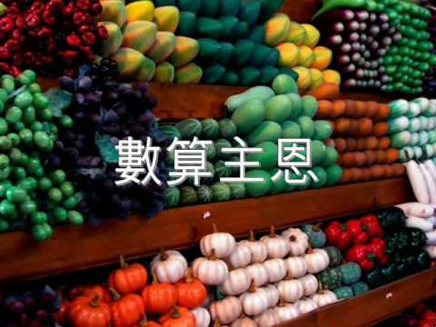
數算主恩
Count Your Blessings

Slide 2
当痛苦像大风浪你无法挡
当你忧愁害怕好像没希望
若把主的恩典从头数一数
必能叫你惊讶立时乐欢呼
When upon life’s billows you are tempest-tossed When you are discouraged Count your many blessings name them one by one And it will surprise you what the Lord has done

Slide 3
主的恩典样样都要数
主的恩典都要记清楚
主的恩典样样都要数
必能叫你惊讶立时乐欢呼
Count your blessings, name them one by one
Count your blessings, see what God has done
Count your blessings, name them one by one
Count your many blessings see what God has done
And it will surprise you what the Lord has done

Slide 4
是否世事挂虑使你心忧闷 是否十架重担使你苦难当 若把主的恩典从头数一数
疑云消散每日歌唱赞美主
Are you ever burdened with a load of care Does the cross seem heavy you are called to bear Count your many blessings, every doubt will fly And you will keep singing as the days go by
Hymns book 270 Count Your Blessings 2/4

Slide 5
主的恩典样样都要数
主的恩典都要记清楚
主的恩典样样都要数
必能叫你惊讶立时乐欢呼
Count your blessings, name them one by one
Count your blessings, see what God has done
Count your blessings, name them one by one
Count your many blessings see what God has done
And it will surprise you what the Lord has done

Slide 6
当你看见世人享受大富贵 不要忘记基督应许的丰富 若把主的恩典从头数一数 世上荣华不能买赎天堂福
When you look at others with their lands and gold Think that Christ has promised you His wealth untold Count your many blessings money cannot buy Your reward in heaven, nor your home on high

Slide 7
主的恩典样样都要数
主的恩典都要记清楚
主的恩典样样都要数
必能叫你惊讶立时乐欢呼
Count your blessings, name them one by one
Count your blessings, see what God has done
Count your blessings, name them one by one
Count your many blessings see what God has done
And it will surprise you what the Lord has done

Slide 8
当痛苦像大风浪你无法挡
当你忧愁害怕好像没希望
若把主的恩典从头数一数
必能叫你惊讶立时乐欢呼
When upon life’s billows you are tempest-tossed When you are discouraged Count your many blessings name them one by one And it will surprise you what the Lord has done

Slide 9
主的恩典样样都要数
主的恩典都要记清楚
主的恩典样样都要数
必能叫你惊讶立时乐欢呼
Count your blessings, name them one by one
Count your blessings, see what God has done
Count your blessings, name them one by one
Count your many blessings see what God has done
And it will surprise you what the Lord has done

